Slide 1
TN Med Helper Findings
Annika Faucon, Cong Wang, Jordan Anderson-Daniels, Prasad Kopparapu

Slide 2
Tennessee Counties of Concern
Which counties have the fewest primary care physicians?
Which counties have the fewest hospitals?
Which counties have the lowest life expectancy?

Slide 3
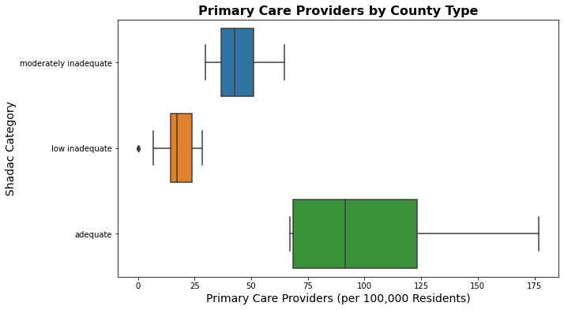
Counties of Concern: ”Low Inadequate”
1500-3500
>3500
<1500

Slide 4
31 ”Low Inadequate” TN Counties
Benton | Crocket | Hawkins | Humphreys | Macon | Perry | Van Buren
Bledsoe | Grainger | Haywood | Jackson | Marshall | Stewart
Cannon | Grundy | Henderson | Lake | Monroe | Tipton
Chester | Hancock | Hickman | Lauderdale | Moore | Trousdale
Clay | Hardeman | Houston | Lewis | Morgan | Union

Slide 5
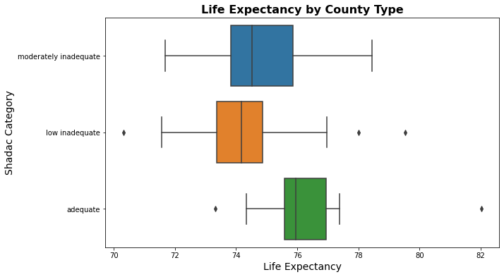
“Low Inadequate” counties have the lowest median life expectancies
1500-3500
>3500
<1500

Slide 6
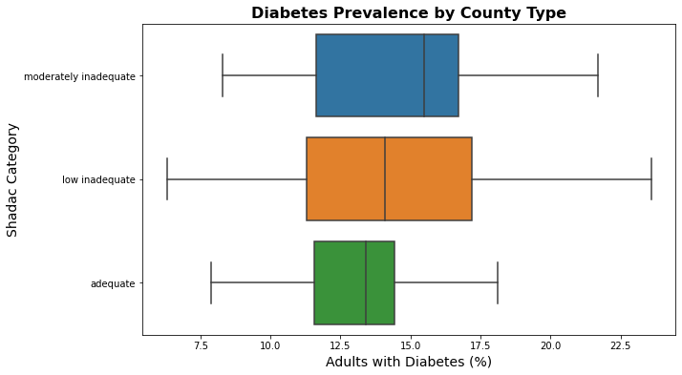
“Low Inadequate” counties have broad Diabetes Prevalence
1500-3500
>3500
<1500

Slide 7
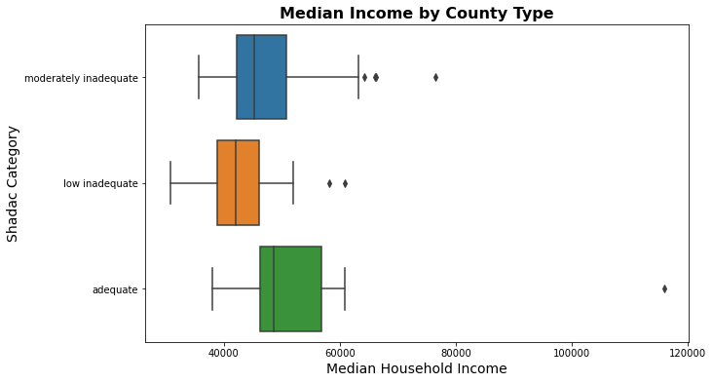
“Low Inadequate” Counties have lowest median household income
1500-3500
>3500
<1500

Slide 8
TN counties with no hospitals
Chester | Lewis | Van Buren
Crockett | Moore
Grainger | Morgan
Grundy | Stewart
Lake | Union

Slide 9
TN counties with no hospitals and no primary care providers
Lake
Crocket
Van Buren
Grundy
County | Life Expectancy | Adults with Diabetes (%) | Median Household Income | % Under 65
Crockett | 74 | 12 | 44431 | 81
Grundy | 72 | 24 | 36317 | 79
Lake | 73 | 11 | 33709 | 84
Van Buren | 74 | 14 | 38265 | 76

Slide 10
TN counties with no hospitals and no primary care providers
Lake
Crocket
Van Buren
Grundy
County | Life Expectancy | Adults with Diabetes (%) | Median Household Income | % Under 65
Crockett | 74 | 12 | 44431 | 81
Grundy | 72 | 24 | 36317 | 79
Lake | 73 | 11 | 33709 | 84
Van Buren | 74 | 14 | 38265 | 76

Slide 11
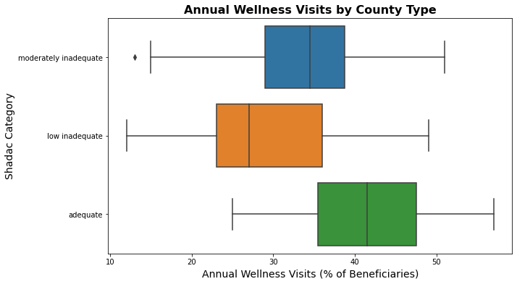
“Low Inadequate” counties tend to have the fewest Annual Wellness visits
1500-3500
>3500
<1500

Slide 12
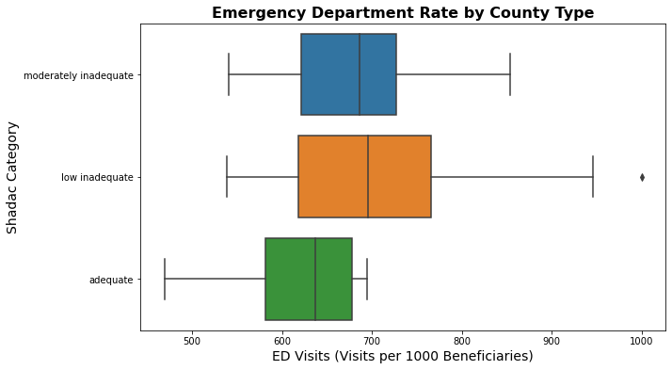
“Low Inadequate” counties tend to have more emergency department visits
1500-3500
>3500
<1500

Slide 13
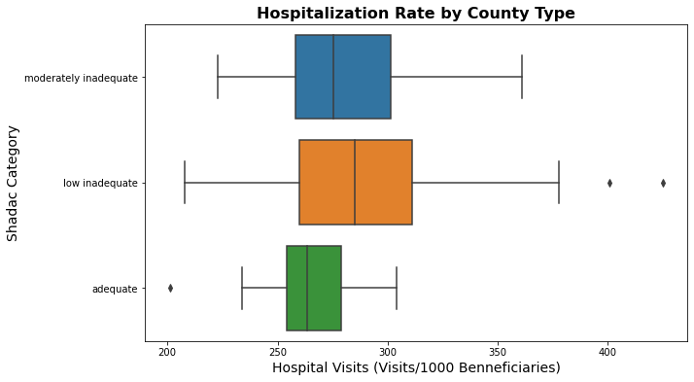
“Low Inadequate” counties tend to have more hospital visits
1500-3500
>3500
<1500

Slide 14
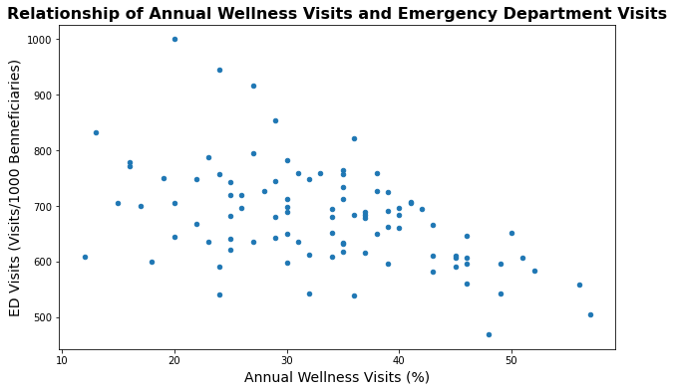
Fewer wellness visits correlates with more emergency department visits
Correlation: -0.48

Slide 15
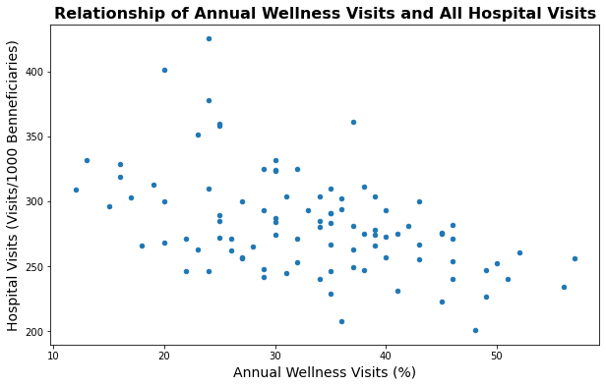
Fewer wellness visits correlates with more hospital visits
Correlation: -0.48

Slide 16
Predict how likely it is that the average person from those counties has not had a checkup in the last year
Select predictors using random forest
Build logistic regression model using individual-level data
Apply model to county-level data

Slide 17
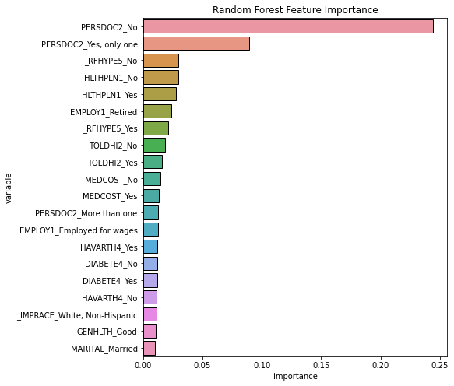
Top 20 predictors
Common variables with county database:
% Uninsured_x
HLTHPLN1_No
% Adults with Diabetes
DIABETE4_No
% Fair or Poor Health
GENHLTH_Good
% Non-Hispanic White
_IMPRACE_White, Non-Hispanic

Slide 18
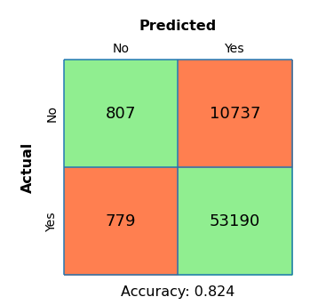
Logistic regression model using 4 predictors
Intercept: 2.81555167
Coefficient:
HLTHPLN1_No: -1.53172365
DIABETE4_No: -1.27379162
GENHLTH_Good: 0.05121252
_IMPRACE_White, Non-Hispanic: -0.02460279

Slide 19
Apply model to County dataset
Top 10 counties with highest predicted value
County Predicted
Trousdale 0.928375
Humphreys 0.926615
Lake 0.926101
Marshall 0.926094
Stewart 0.925302
Moore 0.925279
Cannon 0.925008
Monroe 0.924596
Clay 0.923678
Houston 0.923548

